Slide 1


Noida Institute of Engineering and Technology, Greater Noida
Operating Systems
ACSE0403B
Unit: V
Disk Scheduling & Operating System Customization
SAVITA YADAV
Assistant Professor
IOT Department
4th Semester
(IoT)

Slide 2
Evaluation Scheme
Sl. No. | Subject Codes | Subject Name | Periods |  |  | Evaluation Scheme |  |  |  | End Semester |  | Total | Credit
 |  |  | L | T | P | CT | TA | TOTAL | PS | TE | PE
1 | AAS0402 | Engineering Mathematics- IV | 3 | 1 | 0 | 30 | 20 | 50 |  | 100 |  | 150 | 4
2 | AASL0401 | Technical Communication | 2 | 1 | 0 | 30 | 20 | 50 |  | 100 |  | 150 | 3
3 | ACSE0403B | Operating Systems | 3 | 0 | 0 | 30 | 20 | 50 |  | 100 |  | 150 | 3
4 | ACSAI0402 | Database Management Systems | 3 | 1 | 0 | 30 | 20 | 50 |  | 100 |  | 150 | 4
5 | ACSIOT0401 | Mobile Application Development | 3 | 0 | 0 | 30 | 20 | 50 |  | 100 |  | 150 | 3
6 | ACSE0404 | Theory of Automata and Formal Languages | 3 | 0 | 0 | 30 | 20 | 50 |  | 100 |  | 150 | 3
7 | ACSE0453B | Operating Systems Lab | 0 | 0 | 2 |  |  |  | 25 |  | 25 | 50 | 1
8 | ACSAI0452 | Database Management Systems Lab | 0 | 0 | 2 |  |  |  | 25 |  | 25 | 50 | 1
9 | ACSIOT0451 | Mobile Application Development Lab | 0 | 0 | 2 |  |  |  | 25 |  | 25 | 50 | 1
10 | ACSE0459 | Mini Project using Open Technology | 0 | 0 | 2 |  |  |  | 50 |  |  | 50 | 1
11 | ANC0402 / ANC0401 | Environmental Science*/ Cyber Security*(Non Credit) | 2 | 0 | 0 | 30 | 20 | 50 |  | 50 |  | 100 | 0
 |  | MOOCs** (For B.Tech. Hons. Degree)
 |  | GRAND TOTAL |  |  |  |  |  |  |  |  |  | 1100 | 24

Slide 3
Syllabus
Course Contents / Syllabus
UNIT-I | Fundamental Concepts of Operating System | 8 Hours
 | Introduction, Functions of Operating System, Characteristics of Operating System, Computer System Structure, Evolution of Operating Systems-Bare Machine, Single Processing, Batch Processing, Multiprogramming, Multitasking, Multithreaded, Interactive, Time sharing, Real Time System, Distributed System, Multiprocessor Systems, Multithreaded Systems, System Calls, System Programs and System Boot, Interrupt Handling, Operating System Structure- Simple structure, Layered Structure, Monolithic, Microkernel and Hybrid, System Components, Operating System Services, Case Studies: Windows, Unix and Linux.
UNIT-II | Process Management | 8 Hours
 | Scheduling Concepts, Performance Criteria, Process States, Process Transition Diagram, Schedulers, Process Control Block (PCB), Process Address Space, Process Identification Information, Threads and their management, Types of Scheduling: Long Term Scheduling, Mid Term Scheduling, Short Term Scheduling, Pre-emptive and Non Pre-emptive Scheduling, Dispatcher, Scheduling Algorithm: FCFS, Non Pre-emptive SJF, Pre-emptive SJF, Non Pre-emptive Priority, Pre-emptive Priority, Round Robin, Multilevel Queue Scheduling and Multilevel Feedback Queue Scheduling.

Slide 4
Syllabus
UNIT-III | Deadlock and Concurrent Processing
 | Deadlock: System model, Deadlock characterization, Prevention, Avoidance and detection, Recovery from Deadlock, Principle of Concurrency, Process Synchronization, Producer / Consumer Problem, Mutual Exclusion, Critical Section Problem, Peterson’s Solution, Lamport Bakery Solution, Semaphores, Test and Set Operation; Critical Section Problems and their solutions - Bound Buffer Problem, Reader-Writer Problem, Dining Philosopher Problem, Sleeping Barber Problem; Inter Process Communication Models and Schemes, Process Generation.
UNIT-IV | Memory Management
 | Memory Management function, Address Binding Loading : Compile Time, Load Time and Execution Time, MMU, Types of Linking, Types of Loading, Swapping, Multiprogramming with Fixed Partitions, Multiprogramming with variable partitions, Memory Allocation: Allocation Strategies First Fit, Best Fit, and Worst Fit, Paging, Segmentation, Paged Segmentation, Virtual Memory Concepts, Demand Paging, Performance of Demand Paging, Page Replacement Algorithms: FIFO, LRU, Optimal and LFU, Belady’s Anomaly, Thrashing, Cache Memory Organization, Locality of Reference.
UNIT-V | Disk Scheduling & Operating System Customization
 | Disk Storage: Seek Time, Rotational Latency, Data Transfer Time, Average Access Time and Controller Time. Disk Storage Strategies, Disk Scheduling: FCFS, SSTF, SCAN, C-SCAN, LOOK and C-LOOK, Directory and Directory Structure, File System. Introduction to Raspbian Operating System, History of Linux, Introduction to Linux, Architecture of Linux, Shell & Types of Linux Shell, File and Directory structure, Introduction to linux distributions or Distros, Need of Linux Distros, Linux Customization, Case study:- Real Time Operating System with IoT.

Slide 5
Branch wise Applications
Room lighting
Window shades
Solar loads
Physical security
Fire detection
Elevator
Lift systems.

Slide 6
Course Objective
The objective of the course is to provide an understanding of the basic modules and architecture of an operating system and the functions of the modules to manage, coordinate and control all the parts of the computer system.
This course cover processor scheduling, deadlocks, memory management, process synchronization, system call and file system management.

Slide 7


Course Outcomes
Course outcomes : After completion of this course students will be able to
CO 1 | Understand the fundamentals of an operating systems, functions and their structure and functions. | K1, K2
CO 2 | Implement concept of process management policies, CPU Scheduling and thread management. | K5
CO 3 | Understand and implement the requirement of process synchronization and apply deadlock handling algorithms. | K2, K5
CO 4 | Evaluate the memory management and its allocation policies. | K5
CO 5 | Understand and analyze disk scheduling and real time applications. | K2, K4

Slide 8
Program Outcome
1. Engineering knowledge
2. Problem analysis
3. Design/development of solutions
4.Conduct investigations of complex problems
5. Modern tool usage
6. The engineer and society
7. Environment and sustainability
8. Ethics:
9. Individual and team work
10. Communication
11. Project management and finance
12. Life-long learning

Slide 9
CO-PO Mapping
Mapping of Course Outcomes and Program Outcomes:
OPERATING SYSTEM (ACSE0403A )
CODE | PO1 | PO2 | PO3 | PO4 | PO5 | PO6 | PO7 | PO8 | PO9 | PO10 | PO11 | PO12
ACSE0403A .1 | 3 | 3 | 2 | 2 | 1 | 2 | - | 2 | 3 | 2 | 2 | 3
ACSE0403A .2 | 3 | 3 | 3 | 2 | 2 | 3 | 2 | 2 | 3 | - | 1 | 3
ACSE0403A .3 | 3 | 3 | 2 | 2 | 2 | 2 | 2 | 2 | 2 | 3 | 1 | 3
ACSE0403A .4 | 3 | 2 | 2 | 3 | 1 | 2 | 2 | - | 2 | - | 2 | 3
ACSE0403A .5 | 3 | 1 | 2 | 2 | 2 | 2 | - | - | 2 | 2 | 2 | 3

Slide 10
Ge
End Semester Question paper Templates
General Instructions:
All questions are compulsory. Answers should be brief and to the point.
This Question paper consists of …………pages & …8………questions.
It comprises of three Sections, A, B, and C. You are to attempt all the sections.
Section A -Question No- 1 is objective type questions carrying 1 mark each, Question No- 2 is very short
answer type carrying 2 mark each. You are expected to answer them as directed.
Section B - Question No-3 is Long answer type -I questions with external choice carrying 6 marks each.
You need to attempt any five out of seven questions given.
Section C - Question No. 4-8 are Long answer type –II (within unit choice) questions carrying 10 marks
each. You need to attempt any one part a or b.
Students are instructed to cross the blank sheets before handing over the answer sheet to the invigilator.
No sheet should be left blank. Any written material after a blank sheet will not be evaluated/checked.

Slide 11
 |  | SECTION – A |  | CO
 | Attempt all parts- |  | [10×1=10]
 | 1-a. | Question- | (1)
 | 1-b. | Question- | (1)
 | 1-c. | Question- | (1)
 | 1-d. | Question- | (1)
 | 1-e. | Question- | (1)
 | 1-f. | Question- | (1)
 | 1-g. | Question- | (1)
 | 1-h. | Question- | (1)
 | 1-i. | Question- | (1)
 | 1-j. | Question- | (1)
2. | Attempt all parts- |  | [5×2=10] | CO
 | 2-a. | Question- | (2)
 | 2-b. | Question- | (2)
 | 2-c. | Question- | (2)
 | 2-d. | Question- | (2)
 | 2-e. | Question- | (2)

Slide 12
SECTION – B |  |  |  | CO
3. | Answer any five of the following- |  | [5×6=30]
 | 3-a. | Question- | (6)
 | 3-b. | Question- | (6)
 | 3-c. | Question- | (6)
 | 3-d. | Question- | (6)
 | 3-e. | Question- | (6)
 | 3-f. | Question- | (6)
 | 3-g. | Question- | (6)
SECTION – C |  |  |  | CO
4 | Answer any one of the following- |  | [5×10=50]
 | 4-a. | Question- | (10)
 | 4-b. | Question- | (10)
5. | Answer any one of the following-
 | 5-a. | Question- | (10)
 | 5-b. | Question- | (10)
6. | Answer any one of the following-
 | 6-a. | Question- | (10)
 | 6-b. | Question- | (10)
7. | Answer any one of the following-
 | 7-a. | Question- | (10)
 | 7-b. | Question- | (10)
8. | Answer any one of the following-
 | 8-a. | Question- | (10)
 | 8-b. | Question- | (10)

Slide 13
Prerequisite and Recap
Basic knowledge of computer fundamentals
Basic Knowledge of Data structure
Basic knowledge of Computer organization.
Memory hierarchy
Cache Organization
Interrupt
Registers
Associative memory

Slide 14
Brief Introduction about the Subject with videos
An operating system acts as an intermediary between the user of a computer and computer hardware. The purpose of an operating system is to provide an environment in which a user can execute programs conveniently and efficiently.
YouTube/other Video Links
https://www.youtube.com/playlist?list=PLmXKhU9FNesSFvj6gASuWmQd23Ul5omtD

Slide 15
Unit Contents
Disk Storage: Seek Time, Rotational Latency, Data Transfer Time, Average Access Time and Controller Time.
Disk Storage Strategies
Disk Scheduling: FCFS, SSTF, SCAN, C-SCAN, LOOK and C-LOOK
Directory and Directory Structure
File System.
Introduction to Raspbian Operating System
History of Linux
Introduction to Linux
Architecture of Linux
Shell & Types of Linux Shell
File and Directory structure
Introduction to linux distributions or Distros
Need of Linux Distros
Linux Customization
Case study:- Real Time Operating System with IoT.

Slide 16
Unit Objective
The objective of the unit is
To provide an understanding of the basic structure of Disk and disk scheduling.
To provide understanding of Linux Operating System and Distributions.

Slide 17
Disk storage
Disk storage (also sometimes called drive storage) is a general category of storage mechanisms where data is recorded by various electronic, magnetic, optical, or mechanical changes to a surface layer of one or more rotating disks.
A disk drive is a device implementing such a storage mechanism.

Slide 18
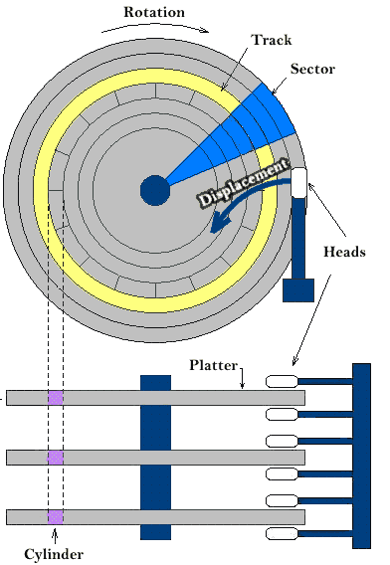
Disk structure

Slide 19
Basic terminology
Disk - Generally refers to magnetic media and devices.
Disc - Required by trademarks for certain optical media and devices.
Platter – An individual recording disk. A hard disk drive contains a set of platters. Developments in optical technology have led to multiple recording layers on DVDs.
Spindle – the spinning axle on which the platters are mounted.
Rotation – Platters rotate; two techniques are common:
Constant angular velocity (CAV) keeps the disk spinning at a fixed rate, measured in revolutions per minute (RPM). This means the heads cover more distance per unit of time on the outer tracks than on the inner tracks. This method is typical with computer hard drives.
Constant linear velocity (CLV) keeps the distance covered by the heads per unit time fixed. Thus the disk has to slow down as the arm moves to the outer tracks. This method is typical for CD drives.

Slide 20
Basic terminology
Track – The circle of recorded data on a single recording surface of a platter.
Sector – A segment of a track
Low level formatting – Establishing the tracks and sectors.
Head – The device that reads and writes the information—magnetic or optical—on the disk surface.
Arm – The mechanical assembly that supports the head as it moves in and out.

Slide 21
Basic terminology
Some important terms must be noted here:
Seek time – The time taken by the R-W head to reach the desired track from it’s current position.
Rotational latency – Time taken by the sector to come under the R-W head.
Data transfer time – Time taken to transfer the required amount of data. It depends upon the rotational speed.
Controller time – The processing time taken by the controller.
Average Access time – seek time + Average Rotational latency + data transfer time + controller time.

Slide 22
Disk Scheduling
The operating system is responsible for using hardware efficiently — for the disk drives, this means having a fast access time and disk bandwidth.
Disk bandwidth is the total number of bytes transferred, divided by the total time between the first request for service and the completion of the last transfer.
Accomplish this by minimizing seek time
Seek time approximates seek distance

Slide 23
Disk I/O Request
Disk I/O request specifies
whether the operation is input or output
disk address (block number, which is translated into drive, cylinder, surface, and sector coordinates)
memory address to copy to or from
byte count giving the amount of inform ation to be transfered

Slide 24
Disk Scheduling
Many requests may be pending at once. Which should be handled first?
Head moving strategy developed
Attempting to manage the overall disk seek time. Latency is not controllable and transfer time depends on the size of the transfer request
Different strategies:
FCFS
SSTF
SCAN
C-SCAN
LOOK
C-LOOK

Slide 25
FCFS Scheduling
Simplest form
First-come, first-served scheduling
Requests served in order of arrival
Advantage: simple queueing
Disadvantage: does not provide the “best” seek time

Slide 26
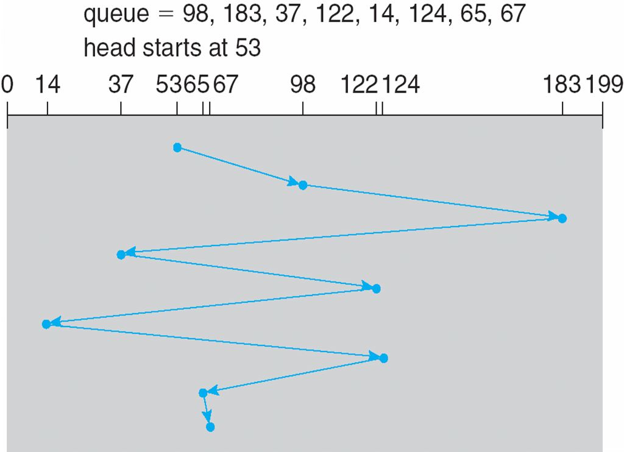
FCFS
Illustration shows total head movement of 640 cylinders

Slide 27
SSTF
Shortest Seek Time First selects the request with the minimum seek time from the current head position
SSTF scheduling is a form of SJF scheduling; may cause starvation of some requests.
Illustration shows total head movement of 236 cylinders

Slide 28
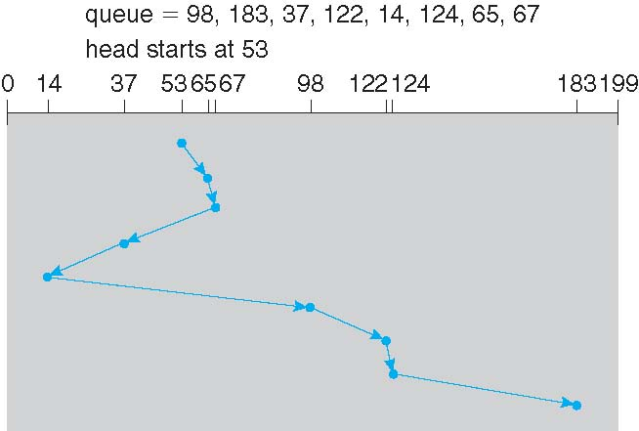
SSTF

Slide 29
SCAN
The disk arm starts at one end of the disk, and moves toward the other end, servicing requests until it gets to the other end of the disk, where the head movement is reversed and servicing continues
SCAN algorithm sometimes called the elevator algorithm
Illustration shows total head movement of 208 cylinders

Slide 30
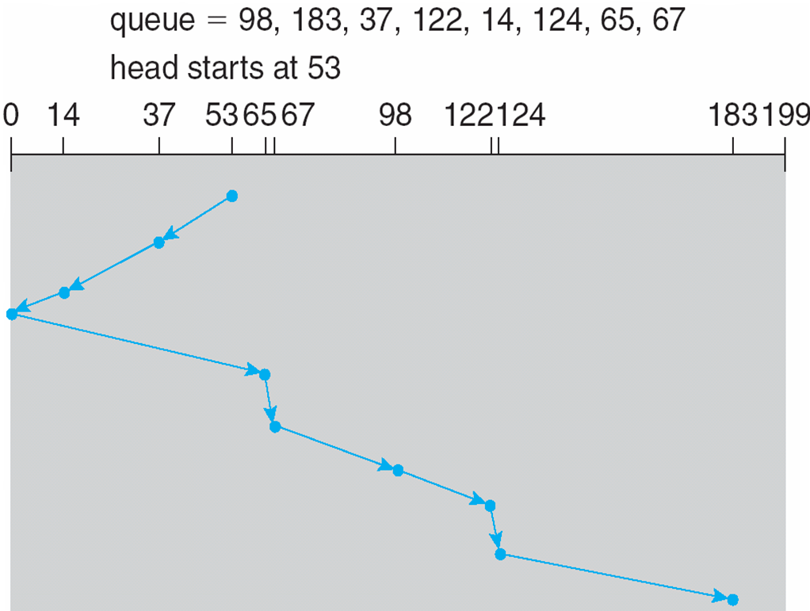
SCAN

Slide 31
C-SCAN
Provides a more uniform wait time than SCAN
The head moves from one end of the disk to the other, servicing requests as it goes
when it reaches the other end, however, it immediately returns to the beginning of the disk, without servicing any requests on the return trip
Treats the cylinders as a circular list that wraps around from the last cylinder to the first one

Slide 32
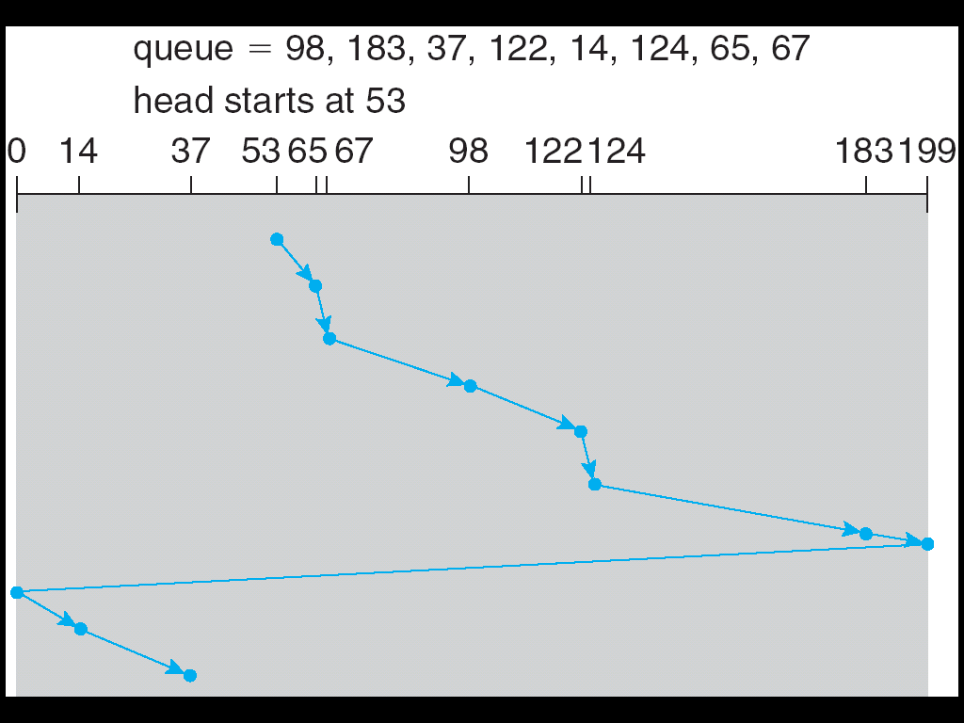
C-SCAN

Slide 33
LOOK & C-LOOK
LOOK a version of SCAN, C-LOOK a version of C-SCAN
Arm only goes as far as the last request in each direction, then reverses direction immediately, without first going all the way to the end of the disk

Slide 34
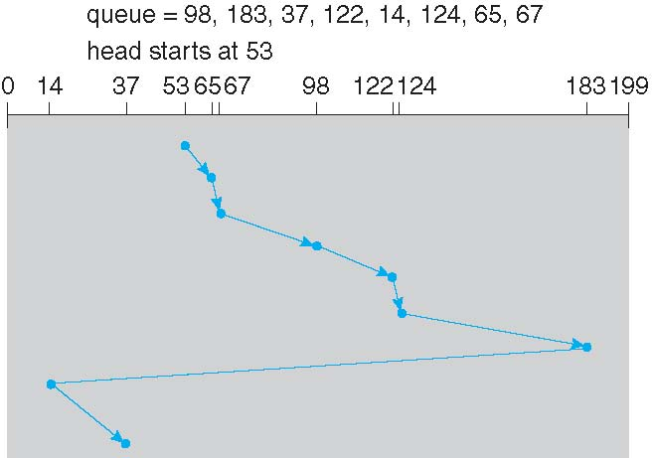
C-LOOK

Slide 35
File Concept
Contiguous logical address space
File = collection of related information recorded on secondary storage
Types:
Data
Numeric (text, ASCII; “LINE_MAX” bytes)
Character (text, ASCII; “LINE_MAX” bytes)
Binary (executable, readable by computer)
Program

Slide 36
File Structure
None - sequence of words, bytes
Simple record structure
Lines
Fixed length
Variable length
Complex Structures
Formatted document
Who decides:
Operating system
Program

Slide 37
File Attributes
Name – only information kept in human-readable form
Identifier – unique tag (number) identifies file within file system
Type – needed for systems that support different types
Location – pointer to file location on device
Size – current file size
Protection (ACL) – controls who can do reading, writing, executing
Time, date, and user identification – data for protection, security, and usage monitoring
Information about files are kept in the directory structure, which is maintained on the disk

Slide 38
File Operations
File is an abstract data type
Basic operations on files:
Create
Write
Read
Reposition within file
Delete
Truncate
Open(F_{i}) – search the directory structure on disk for entry F_{i}, and move the content of entry to memory
Close (F_{i}) – move the content of entry F_{i} in memory back to directory structure on disk
Opening files: “remember” used files; efficiency; convenience

Slide 39
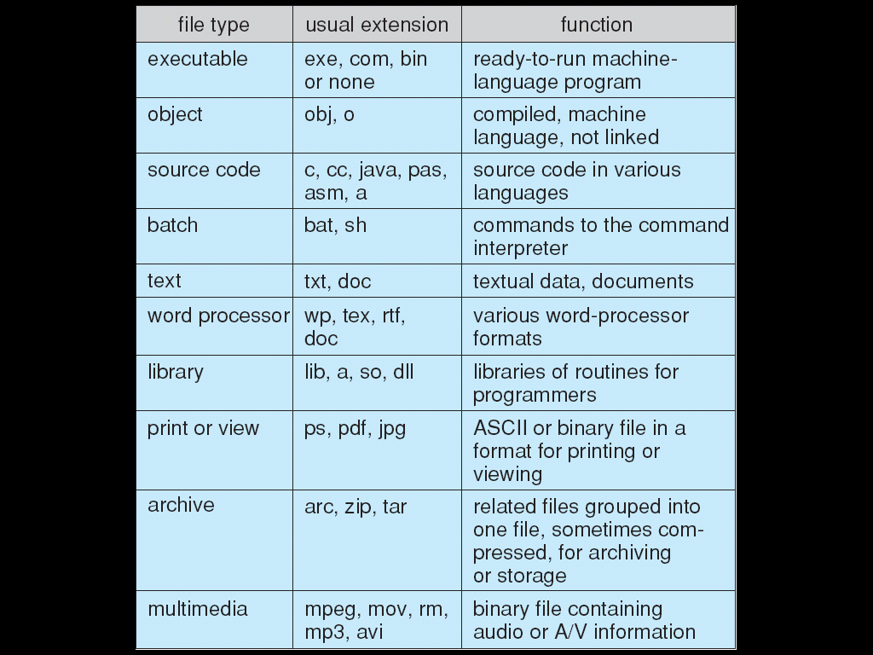
File Types – Name, Extension

Slide 40
Access Methods
Sequential Access
read next
write next
reset
skip forward
Direct Access
read n
write n
position to n
read next
write next
rewrite n
n = relative block number

Slide 41
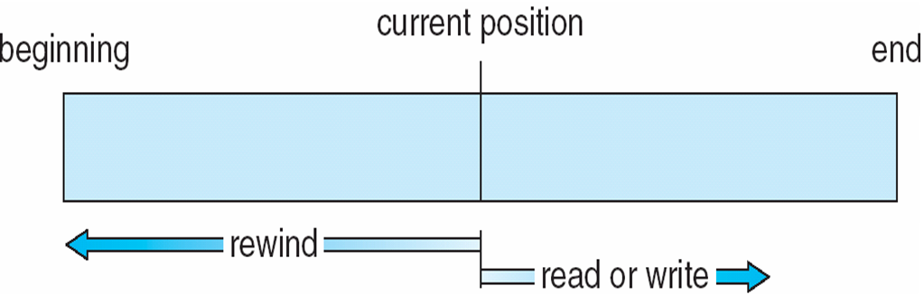
Sequential-Access File

Slide 42
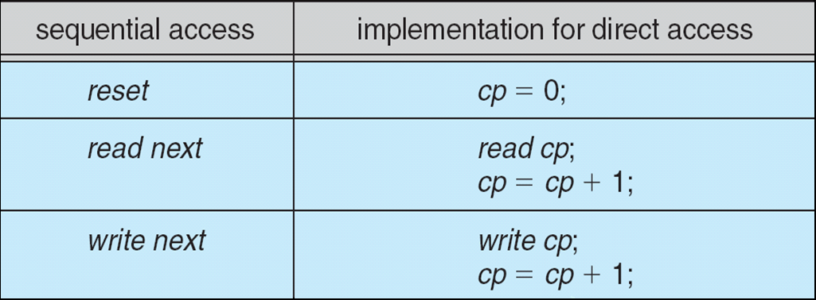
Simulation of Sequential Access on Direct-Access File

Slide 43
Directory Structure
A directory is a container that is used to contain folders and files. It organizes files and folders in a hierarchical manner.

Slide 44
Operations Performed on Directory
Search for a file
Create a file
Delete a file
List a directory
Rename a file
Traverse the file system

Slide 45
Directory Structure
Directory is Organize to Obtain
Efficiency – locating a file quickly
Naming – convenient to users
Two users can have same name for different files
The same file can have several different names
Grouping – logical grouping of files by properties

Slide 46
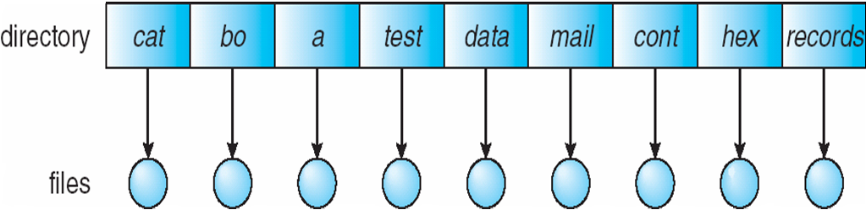
Single-Level Directory
A single directory for all users
Naming problem
Grouping problem

Slide 47
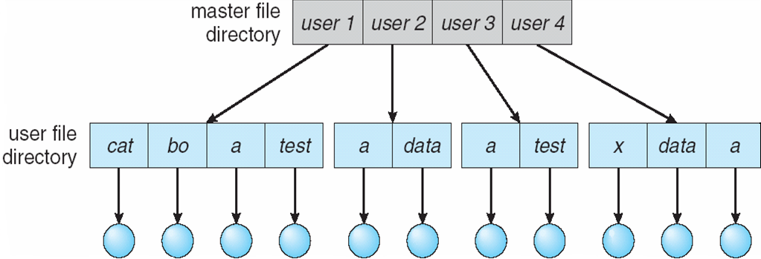
Two-Level Directory
Separate directory for each user
Path name
Can have the same file name for different user
Efficient searching
No grouping capability

Slide 48
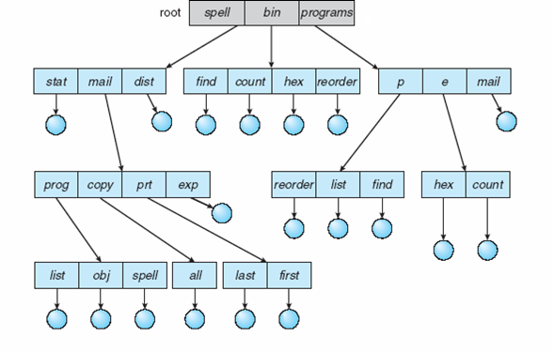
Tree-Structured Directories

Slide 49
Tree-Structured Directories
Efficient searching
Grouping Capability
Current directory (“working directory”)
cd /spell/mail/prog
cd ~
cd .
cd ..

Slide 50
Tree-Structured Directories
Absolute or relative path name
Creating a new file is done in current directory
Delete a file
rm <file-name>
Creating a new subdirectory is done in current directory
mkdir <dir-name>
Example: if in current directory /mail
mkdir count

Slide 51
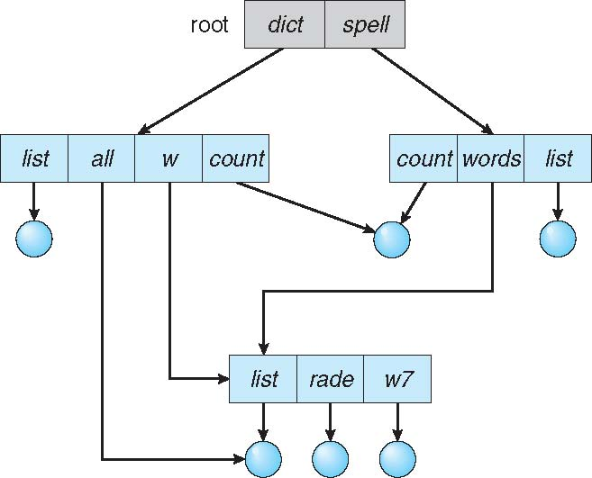
Acyclic-Graph Directories
Have shared subdirectories and files

Slide 52
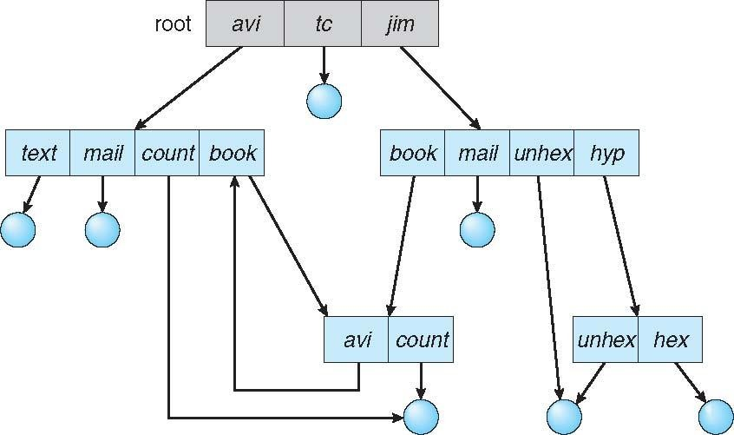
General Graph Directory
.

Slide 53
General Graph Directory
How do we guarantee no cycles?
Allow only links to files, not subdirectories
Every time a new link is added use a cycle detection algorithm to determine whether it is OK
Ignore links for activities such as recursive search/delete/etc.

Slide 54
What is Raspberry Pi?
One line answer to the about question would be, “Pi is a single-board computer”.
Pi is a small scale computer in the size little bigger than a credit card, it packs enough power to run games, word processor like open office, image editor like Gimp and any program of similar magnitude.
Pi was introduced as an educational gadget to be used for protyping by hobbyists and for those who want to learn more about programming.
It certainly cannot be a substitute for our day to day Linux, Mac or Windows PC.
Pi is based on a Broadcom SoC (System of Chip) with an ARM processor [~700 MHz], a GPU and 256 to 512 MB RAM.
The boot media is an SD card [which is not included], and the SD card can also be used for persist data.

Slide 55
Introduction to Raspbian Operating System
Raspian OS is one of the official Operating systems available for free to download and use.
The system is based on Debian Linux and is optimized to work efficiently with the Raspberry Pi computer.
As we already know an OS is a set of basic programs and utilities that runs on a specified hardware, in this case the Pi.
Debian is very lightweight and makes a great choice for the Pi.
The Raspbian includes tools for browsing, python programming and a GUI desktop.
The Raspian desktop environment is known as the “Lightweight X11 Desktop Environment” or in short LXDE.
This has a fairly attractive user interface that is built using the X Window System software and is a familiar point and click interface.
We shall look more into how to install and use this OS in the next section.

Slide 56
History of Linux
Linux is named after Linus Torvalds (pronounced "LYNNus", hence "LYNN-ucks"),
He wrote the first Linux kernel in 1991.
At the time, he was a Computer Science undergraduate student at the University of Helsinki, Finland, and wanted a hobby project which he intended to release as a free OS
Linus retains control of the Linux kernel to this day, through a small company, though he also has (had?) a day job in Silicon Valley.
He had some technical differences with Minix and with its creator (Professor Andrew Tannenbaum, Computer Science, at a university in the Nederland), and so Linus wanted to do it his way.
Linux is released under the GPL, the Free (as in free speech, not free beer) Software Foundation's General Public License.
This is sometimes called the "copyleft" (as opposed to "copyright").

Slide 57
Introduction to Linux
Multi-User
Several users can log in locally and/or remotely to the Linux workstation/server and work concurrently
Multi-process / Multitasking
Allows for running multiple applications using preemptive multitasking at the O/S level
Multi-Processor
The Linux kernel currently supports running multiple concurrent CPU’s on any given system.

Slide 58
Architecture of Linux
Three software layers are typically used to describe the Linux system:
The kernel layer:
This runs the hardware and allocates resources, sharing them where necessary. The file system is often a separate process, as are other parts of the kernel and various service daemons.
The shell and other basic utilities layer:
When you type in a command, it's to the shell at the command-line interface (sometimes CLI).
Some commands are built-in to the shell (e.g., cd for change directory)
some are programs or filters (like grep, global regular expression and print).
All programs will use system calls to request the many and varied kernel and kernel-mediated services.
The applications layer:
Where programs like gcc and vi will run, also using system calls to request services from the kernel

Slide 59
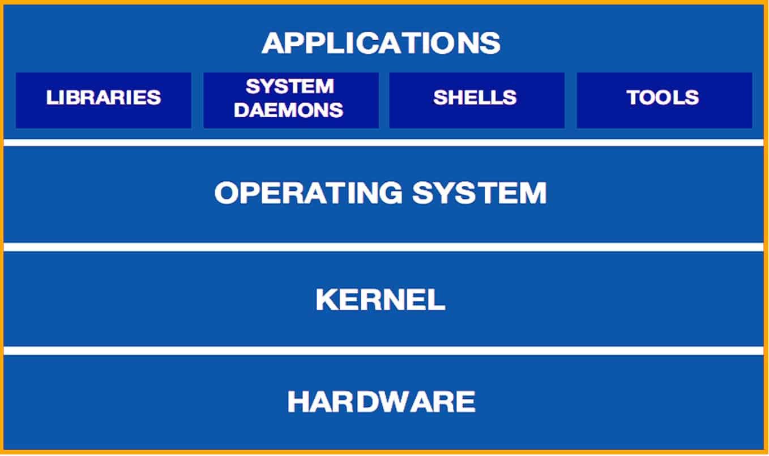
Architecture of Linux

Slide 60
Shell
A shell is a program that provides an interface between a user and an operating system (OS) kernel. An OS starts a shell for each user when the user logs in or opens a terminal or console window.
A kernel is a program that:
Controls all computer operations.
Coordinates all executing utilities
Ensures that executing utilities do not interfere with each other or consume all system resources.
Schedules and manages all system processes.
By interfacing with a kernel, a shell provides a way for a user to execute utilities and programs.

Slide 61
User Environment
The shell also provides a user environment that you can customize using initialization files. These files contain settings for user environment characteristics, such as:
Search paths for finding commands.
Default permissions on new files.
Values for variables that other programs use.
Values that you can customize.

Slide 62
Types of Linux Shell
Types of Linux Shell:-
1. The C Shell
2. The Bourne Shell
3. The Korn Shell
4. GNU Bourne-Again Shell

Slide 63
The C Shell
Denoted as csh
Bill Joy created it at the University of California at Berkeley.
It incorporated features such as aliases and command history.
It includes helpful programming features like built-in arithmetic and C-like expression syntax.
In C shell:
Command full-path name is /bin/csh,
Non-root user default prompt is hostname %,
Root user default prompt is hostname #.

Slide 64
The Bourne Shell
Denoted as sh
It was written by Steve Bourne at AT&T Bell Labs.
It is the original UNIX shell. It is faster and more preferred.
It lacks features for interactive use like the ability to recall previous commands.
It also lacks built-in arithmetic and logical expression handling.
It is default shell for Solaris OS.
For the Bourne shell the:
Command full-path name is /bin/sh and /sbin/sh,
Non-root user default prompt is $,
Root user default prompt is #.

Slide 65
The Korn Shell
It is denoted as ksh
It Was written by David Korn at AT&T Bell Labs
It is a superset of the Bourne shell.
So it supports everything in the Bourne shell.
It has interactive features.
It includes features like built-in arithmetic and C-like arrays, functions, and string-manipulation facilities.
It is faster than C shell.
It is compatible with script written for C shell.
For the Korn shell the:
Command full-path name is /bin/ksh,
Non-root user default prompt is $,
Root user default prompt is #.

Slide 66
GNU Bourne-Again Shell
Denoted as bash
It is compatible to the Bourne shell.
It includes features from Korn and Bourne shell.
For the GNU Bourne-Again shell the:
Command full-path name is /bin/bash,
Default prompt for a non-root user is bash-g.gg$
(g.ggindicates the shell version number like bash-3.50$),
Root user default prompt is bash-g.gg#.

Slide 67
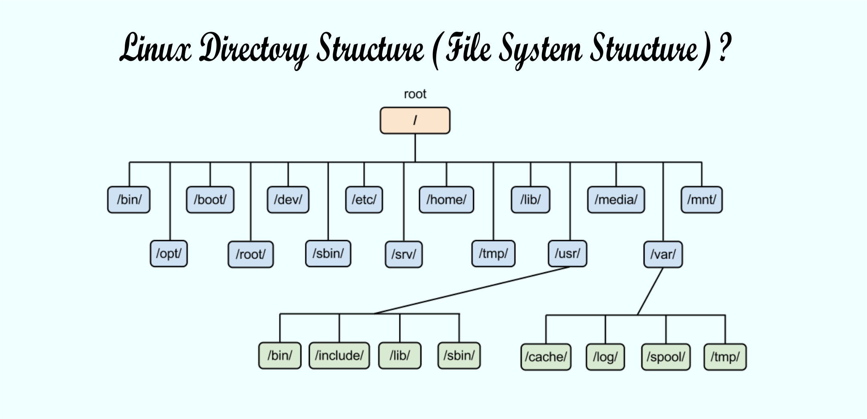
File and Directory structure

Slide 68
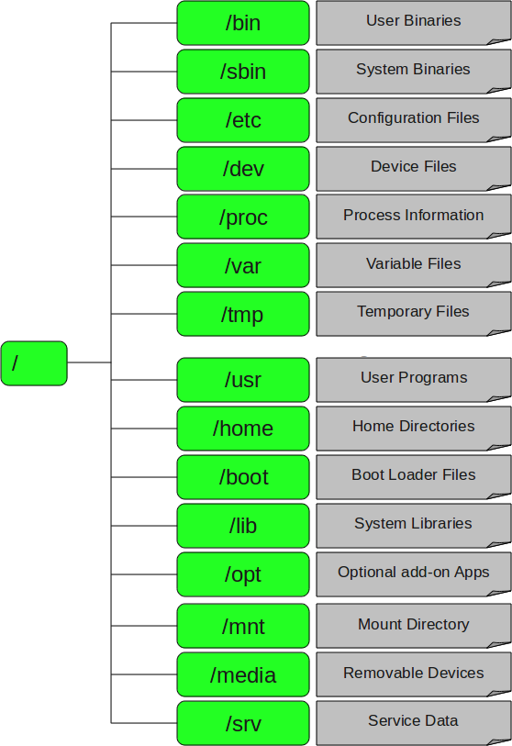
File and Directory structure

Slide 69
File and Directory structure
1. / – Root
Every single file and directory starts from the root directory.
Only root user has write privilege under this directory.
Please note that /root is root user’s home directory, which is not same as /.
2. /bin – User Binaries
Contains binary executables.
Common linux commands you need to use in single-user modes are located under this directory.
Commands used by all the users of the system are located here.
For example: ps, ls, ping, grep, cp.

Slide 70
File and Directory structure
3. /sbin – System Binaries
Just like /bin, /sbin also contains binary executables.
But, the linux commands located under this directory are used typically by system aministrator, for system maintenance purpose.
For example: iptables, reboot, fdisk, ifconfig, swapon
4. /etc – Configuration Files
Contains configuration files required by all programs.
This also contains startup and shutdown shell scripts used to start/stop individual programs.
For example: /etc/resolv.conf, /etc/logrotate.conf

Slide 71
File and Directory structure
5. /dev – Device Files
Contains device files.
These include terminal devices, usb, or any device attached to the system.
For example: /dev/tty1, /dev/usbmon0
6. /proc – Process Information
Contains information about system process.
This is a pseudo filesystem contains information about running process. For example: /proc/{pid} directory contains information about the process with that particular pid.
This is a virtual filesystem with text information about system resources. For example: /proc/uptime

Slide 72
File and Directory structure
7. /var – Variable Files
var stands for variable files.
Content of the files that are expected to grow can be found under this directory.
This includes — system log files (/var/log); packages and database files (/var/lib); emails (/var/mail); print queues (/var/spool); lock files (/var/lock); temp files needed across reboots (/var/tmp);
8. /tmp – Temporary Files
Directory that contains temporary files created by system and users.
Files under this directory are deleted when system is rebooted.

Slide 73
File and Directory structure
9. /usr – User Programs
Contains binaries, libraries, documentation, and source-code for second level programs.
/usr/bin contains binary files for user programs. If you can’t find a user binary under /bin, look under /usr/bin. For example: at, awk, cc, less, scp
/usr/sbin contains binary files for system administrators. If you can’t find a system binary under /sbin, look under /usr/sbin. For example: atd, cron, sshd, useradd, userdel
/usr/lib contains libraries for /usr/bin and /usr/sbin
/usr/local contains users programs that you install from source. For example, when you install apache from source, it goes under /usr/local/apache2
10. /home – Home Directories
Home directories for all users to store their personal files.
For example: /home/john, /home/nikita

Slide 74
File and Directory structure
11. /boot – Boot Loader Files
Contains boot loader related files.
Kernel initrd, vmlinux, grub files are located under /boot
For example: initrd.img-2.6.32-24-generic, vmlinuz-2.6.32-24-generic
12. /lib – System Libraries
Contains library files that supports the binaries located under /bin and /sbin
Library filenames are either ld* or lib*.so.*
For example: ld-2.11.1.so, libncurses.so.5.7
13. /opt – Optional add-on Applications
opt stands for optional.
Contains add-on applications from individual vendors.
add-on applications should be installed under either /opt/ or /opt/ sub-directory.

Slide 75
File and Directory structure
14. /mnt – Mount Directory
Temporary mount directory where sysadmins can mount filesystems.
15. /media – Removable Media Devices
Temporary mount directory for removable devices.
For examples, /media/cdrom for CD-ROM; /media/floppy for floppy drives; /media/cdrecorder for CD writer
16. /srv – Service Data
srv stands for service.
Contains server specific services related data.
For example, /srv/cvs contains CVS related data.

Slide 76
Introduction to linux distributions or Distros
Linux distribution is a Linux Distributor assembled collection of program packages.
Linux Distribution consists of at least the Linux kernel and some needed system programs.
These programs often come from the still older GNU project license, an alternative to commercial UNIX Like OS to develop, with its own kernel.
Linux Distribution colloquially known as Linux Distro.

Slide 77
Some popular Linux Distribution
List of some popular Linux Distribution :
Debian comes itself or has many sub and sub sub Linux Distribution.
Arch Linux is minimalistic Linux Distribution
Fedora is a community linux distribution comes itself or has many sub and sub sub Linux Distribution.
Linux Mint
Ubuntu
Pop_OS! from System76
MX Linux
Elementary OS
Zorin

Slide 78
Need of Linux Distros
Very Secure
Stable
Free and Open Source
Easy to Use
Absolute Freedom Over Your System
High Performance
Proper Use of System Resources
Privacy Friendly
Easily Install Software
Better Software Updates

Slide 79
Linux Customization
Customization can take many forms. You can customize the desktop of course, change the background, the color of the windows, or the screen saver. These things you can do in most modern operating systems. But that is only the tip of the iceberg so to speak. Here is a list of some of the things you could customize, but I should remind you, in Linux you can change EVERYTHING.
Installed Applications is one of the areas many people forget. If you don’t want to use Mozilla email, there are alternatives.
Window Manager is a major change available in Linux, but not in other non-unix operating systems. Don’t like KDE, try Gnome, or XFCE, or ICE or something else.
Graphical or CLI interface is an option. You do not have to start the graphical interface if you don’t want it. This can be useful for servers, or even laptops.
Some Hardware features can be modified or customized for you. For example, I often swap the caps-lock and the left control keys.
The command line can be tuned to do special operations simply. Setting the environment is only the beginning of what you can modify.

Slide 80
Case study:- Real Time Operating System with IoT.
https://www.researchgate.net/publication/306519267_Real_Time_Operating_System_for_the_Internet_of_Things_Vision_Architecture_and_Research_Directions

Slide 81
DAILY QUIZ
Q1. In the ______ algorithm, the disk arm starts at one end of the disk and moves toward the other end, servicing requests till the other end of the disk. At the other end, the direction is reversed and servicing continues.
LOOK
SCAN
C-SCAN
C-LOOK
Q2. In the sequential access method, information in the file is processed ____________
one disk after the other, record access doesnt matter
one record after the other
one text document after the other
none of the mentioned

Slide 82
DAILY QUIZ
Q3. Random access in magnetic tapes is _________ compared to magnetic disks.
Fast
very fast
Slow
very slow
Q4. Consider a disk queue with requests for I/O to blocks on cylinders 98 183 37 122 14 124 65 67 Considering FCFS (first come first served) scheduling, the total number of head movements is, if the disk head is initially at 53 is?
600
620
630
640

Slide 83
DAILY QUIZ
Q5. Data cannot be written to secondary storage unless written within a ______
File
swap space
directory
text format
Q6. The Command do you use to create Linux file system is –
fsck
mkfs
mount
None of the mentioned

Slide 84
DAILY QUIZ
Q7. In the ______ algorithm, the disk arm starts at one end of the disk and moves toward the other end, servicing requests till the other end of the disk. At the other end, the direction is reversed and servicing continues.
LOOK
SCAN
C-SCAN
C-LOOK
Q8. In the ______ algorithm, the disk arm goes as far as the final request in each direction, then reverses direction immediately without going to the end of the disk.
LOOK
SCAN
C-SCAN
C-LOOK

Slide 85
DAILY QUIZ
Q9. Core of Linux operating system is_____________ .
Shell
Kernel
Terminal
Command
Q10. Which of the following directory contains configuration files in Linux? A. /dev/
B. /etc/
C. /bin/
D. /root/

Slide 86
DAILY QUIZ
Q11. Which command is used to remove files?
rm
dm
erase
Delete
Q12. ____________ command is used to remove the directory.
rdir
rd
rmdir
None of the above

Slide 87
WEEKLY ASSIGNMENT
Explain Seek Time and Rotational Latency.
Discuss the file access mechanisms.
Define shell and its types in linux.
Explain Raspbian operating system.
What is the difference between Raspberry Pi OS and Raspbian?
Explain File and Directory structure in Linux.

Slide 88
Faculty Video Links, Youtube & NPTEL Video Links and Online Courses Details
Youtube/other Video Links
https://www.youtube.com/watch?v=aKmuGwHj3Cw
https://www.youtube.com/playlist?list=PLmXKhU9FNesSFvj6gASuWmQd23Ul5omtD
https://www.youtube.com/watch?v=Fizc0nXRm2g
https://www.youtube.com/watch?v=RgYU5r9A5TU
https://nptel.ac.in/courses/106108101

Slide 89
MCQ
Q1. In the sequential access method, information in the file is processed ____________
one disk after the other, record access doesnt matter
one record after the other
one text document after the other
none of the mentioned
Q2. What will happen in the single level directory?
All files are contained in different directories all at the same level
All files are contained in the same directory
Depends on the operating system
None of the mentioned

Slide 90
MCQ
Q3. What will happen in the two level directory structure?
each user has his/her own user file directory
the system doesn’t its own master file directory
all of the mentioned
none of the mentioned
Q4. Which of the following are the types of Path names?
absolute & relative
local & global
global & relative
relative & local

Slide 91
MCQ
Q5. The OS which is not based on Linux is –
BSD
Ubuntu
CentOs
Redhat
Q6. mv command can be used for –
Renaming a file
Move the file to different directory.
Both 1 and 2
None of these

Slide 92
MCQ
Q7. In real time operating system
all processes have the same priority
a task must be serviced by its deadline period
process scheduling can be done only once
kernel is not required
Q8. Which one of the following is a real time operating system?
RTLinux
VxWorks
Windows CE
All of the mentioned

Slide 93
MCQ
Q9. soft real time operating system has ___ jitter than a Hard real time operating system Select one:
less
more
equal
none of the mentioned
Q10. Who founded the Linux Kernel?
Bill Gates
Ben Thomas
Richard Stallman
Linus Torvalds

Slide 94
Glossary Questions
________Symbol that, in the context of file management, refers to the root of the file system; also separates directories in a path listing.
________Symbol that, in the context of file management, refers to the current directory.
Bourne Again SHell. The most common shell interpreter used under Linux and offered as default on many Linux systems.
_______What Windows refers to as a folder; areas on a hard disk in which files can be stored and organized.
______Well-known company that produces distributions of Linux. BASH, / , . , directory , Red Hat

Slide 95
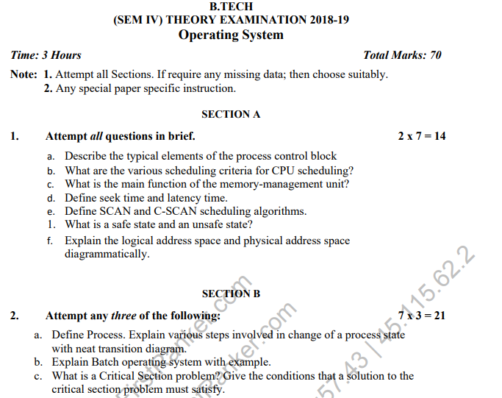
Old Question Paper

Slide 96
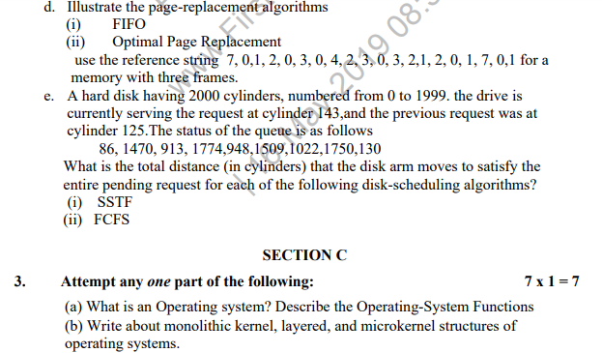
Old Question Paper

Slide 97
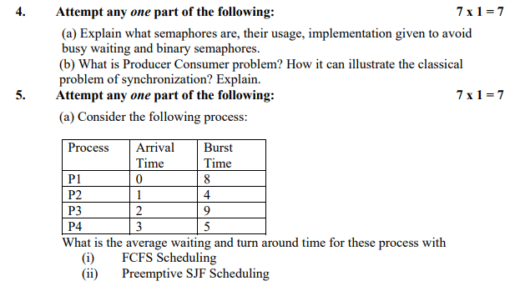
Old Question Paper

Slide 98
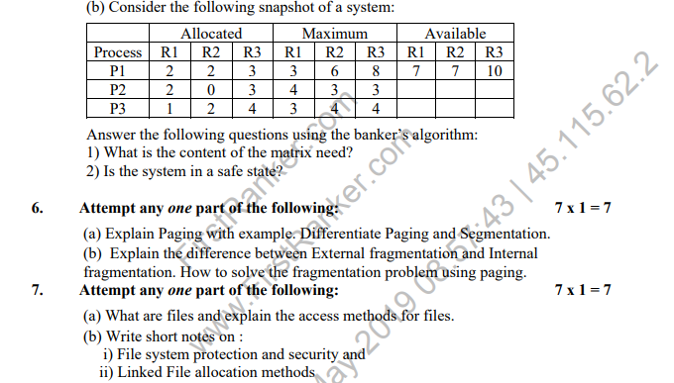
Old Question Paper

Slide 99
Old Question Paper
Last 12 Years University paper Link:-
https://drive.google.com/drive/folders/1UPXvZ7NY09OunSLrEkTFWpw_M3xLzjhs?usp=sharing

Slide 100
Expected Questions
What are the different file organizations? Discuss access mechanisms in detail.
Discuss FCFS, CSCAN, LOOK and CLOOK disk scheduling algorithms with example.
Explain Seek Time and Rotational Latency.
Discuss the file access mechanisms.
Define shell and its types in linux.
Explain Raspbian operating system.
What is the difference between Raspberry Pi OS and Raspbian?
Explain File and Directory structure in Linux.

Slide 101
Noida Institute of Engineering and Technology, Greater Noida
THANK YOU !!

